Slide 1
Original USBasp circuit
That can only switch VCC
between 5V and 3V
but not MOSI/MISO/RST/SCK

Slide 2
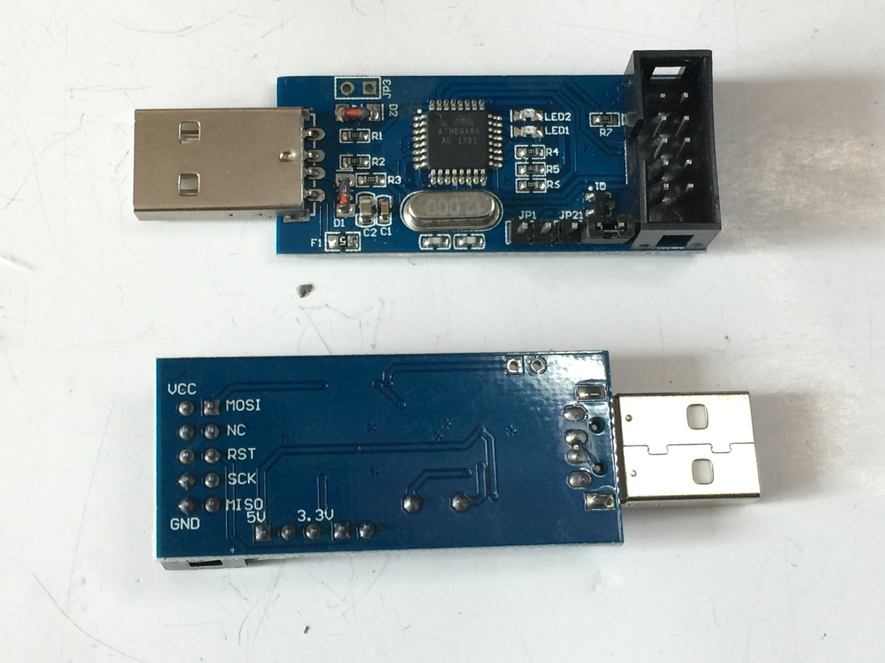
Original USBasp circuit
That can only switch VCC between 5V and 3V
but not MOSI/MISO/RST/SCK

Slide 3
5v
3.3v
x
x
Modified USBasp circuit
To switch MOSI/MISO/RST/SCK
as well as VCC
between 3V and 5V

Slide 4
x
Modified USBasp circuit
That can switch MOSI/MISO/RST/SCK as well as VCC
between 3V and 5V
x

Slide 5
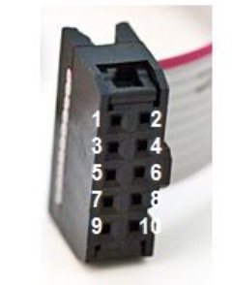
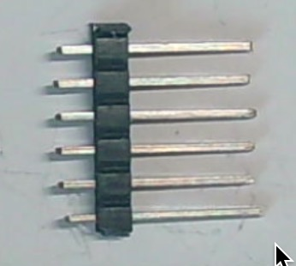
USBasp to homemade Arudboy Cable
For burning boot loader
10-pin female header
VCC
MOSI
RST
SCK
GND
10. MISO
6-pin male header
MISO
GND
VCC
SCK
MOSI
RST

